Slide 1

April 2010
Capital Markets Outlook
Global Rebalancing Drives Sustained Recovery
The information herein reflects prevailing market conditions and our judgments as of the date of the presentation, which are subject to change. In preparing this presentation, we have relied upon and assumed, without independent verification, the accuracy and completeness of all information available from public sources. Opinions and estimates may be changed without notice and involve a number of assumptions which may not prove valid. Neither this presentation nor any of its contents may be used for any purpose without the consent of AllianceBernstein.
Investment Products Offered:
Are Not FDIC Insured
May Lose Value
Are Not Bank Guaranteed
Notes:
Hello. and thank you for joining us today.
Well, in early March, we moved past the anniversary of the bottom of the bear market, and it’s probably not a time that many investors will look back on with fondness.
We’ve come a long way since that low ebb. The world economy has moved from contraction to expansion, capital markets have regained much of their lost ground, and the deep freeze of the world’s financial systems has thawed.
I think we can all agree that March 2010 felt a lot better than a year earlier. The path to recovery certainly hasn’t been straight as an arrow, but the evidence is gathering that the world is on track for a sustainable economic recovery.
Of course, there’s still a long way to go before many investors have fully recovered the loss of their capital during 2008, but the progress from the depths of the recession is unmistakable.

Slide 2
Introduction
Signs of economic recovery proliferate, but not all news is good
Fiscal issues remain the largest threat…
…however, the global economic recovery appears increasingly sustainable
Heightened uncertainty creates attractive opportunities for active managers
Notes:
To begin, here’s how we’d assess the big picture:
Signs of economic recovery proliferate, but not all of the news is good
Fiscal issues remain the largest threat
The recovery is being driven by new demand sources in many developed markets (particularly in the U.S.)
And heightened uncertainty creates attractive opportunities for active managers

Slide 3
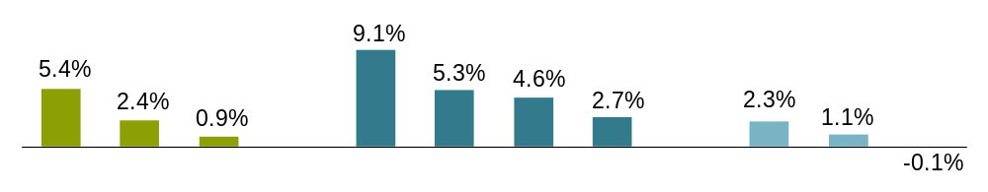
Equities and Credit Continued Their Advance
Returns in USD
1Q:2010 Returns
Equities
Credit
Governments
US
EM
EAFE
US
CMBS
Global
High
Yield
Emerging
Market
Debt
Global
Corp
Euro
Gov’t
US
Gov’t
Japan
Gov’t
Past performance does not guarantee future results.
As of March 31, 2010
Individuals cannot invest directly in an index. Please see slide 27 for index definitions.
Source: Bloomberg, Barclays Capital, MSCI, S&P and AllianceBernstein
Notes:
Global equity markets posted modest gains in the first quarter but the ride was choppy. Markets fell in January amid mounting concern about the sovereign debt crisis in Greece and potential contagion to other countries.
They stabilized in February when European governments stepped in to signal support for Greece and then rallied in March as attention switched to continuing global economic growth and improving corporate earnings. The focus on good news particularly boosted US stocks, allowing the S&P 500 Index to return 5%, its best first quarter since 1998.
Both emerging and developed market international stock Indices (as represented by the MSCI Emerging Market and the EAFE indices, respectively) posted modest but positive returns.
Bond markets continued to embrace risk as investors moved money out of cash. High yield, commercial mortgage-backed securities and emerging market bonds outperformed higher-quality credits. And as investors continued to seek higher yields, government bond returns lagged.
Transition: The prospect of continued improvement in corporate fundamentals, plus a healthier global economic backdrop were key drivers of these strong results. We think that the improvement will continue, leading to continued modest global economic growth…

Slide 4
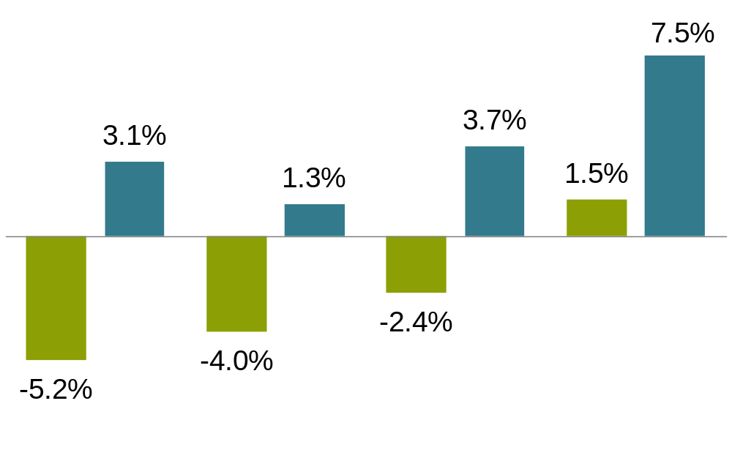
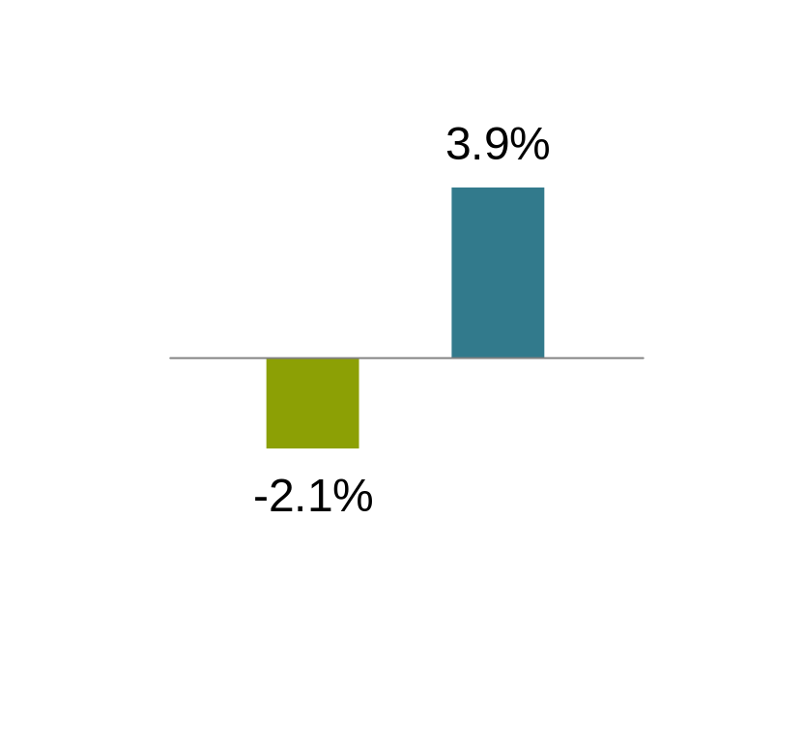
The Economic Outlook Is for Sustained Modest Growth
Carson
UPDATED
3/15
2009 #s are prelim
AllianceBernstein Real GDP Forecasts
Global
Japan
Euro Area
US
Emerging
Countries
2009
2010F
Current estimates and forecasts may not be attained.
As of June1, 2010
Source: AllianceBernstein
Notes:
Our economic forecasts have the world economy growing by 4.0% in 2010, faster than consensus expectations of 3.2%. Emerging markets should lead the way, while the US economy grows 4.0%. Given the strong growth in operating profits and recent acceleration in liquidity flows we are raising our 2010 real us GDP growth forecast to 4%. We expect manufacturing to remain the key driver of the GDP cycle as US firms continue to benefit from the strong growth in overseas markets. Europe will recover at a slower pace. Business activity has clearly moved into expansionary mode, and forward-looking economic indicators are hinting at a sustainable recovery.
Also helping the sustainability of this recovery is a rebalancing of global economic drivers. Middle-class consumers in emerging markets are exerting a greater presence. And they’re increasingly consuming exports from increasingly competitive developed-market manufacturers, which is helping developed economies. But don’t count out developed-market consumers yet—we see signs of a recovery in demand from this important group.
Transition: While the economic news is positive, a key risk to sustained growth is the massive fiscal challenge faced by several countries. These shortfalls were only made worse by the recession…

Slide 5
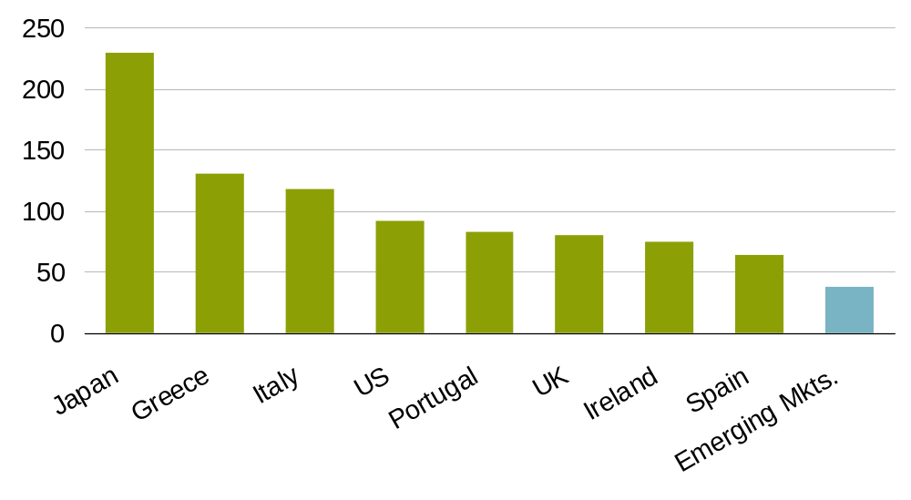
Growth Should Ease Deficits, But Debt Burdens Are a Risk
Gross Debt to GDP: Percent
Historical analysis does not guarantee future results.
As of January 31, 2010
Source: Bloomberg, Haver Analytics, International Monetary Fund, various central banks and AllianceBernstein
Notes:
This chart shows the ratio of debt to gross domestic product, or GDP, of selected countries. Much of the recent attention has focused on countries like Greece and Portugal, given their runaway fiscal spending and mounting debt loads.
While these warrant scrutiny, we feel that the fiscal issues faced by some countries in the euro area will be relatively contained, rather than sparking a broader contagion. Governments have tools, including taxes and spending reductions, which can reduce deficits. The winning formula would be a healthy dose of fiscal discipline combined with plenty of political willpower.
But these acute fiscal worries have also spotlighted similar structural issues and risks in other developed countries like the U.S. and U.K. In both cases, politicians face major challenges in closing fiscal budget gaps.
However, countries have overcome high debt levels in the past, and a high debt ratio doesn’t automatically increase the likelihood of default. In the mid-90s, Belgium, Canada and Sweden aggressively reduced their debt burdens. And other factors can help countries manage higher debt loads, maybe even more effectively than a low-debt nation: lower interest rates on their bonds, as in the case of Japan; ease of issuing debt denominated in their home currency; and even strong competitive advantages that generate economic growth.
Transition: Our view is that while structural problems will persist, economic growth should ease debt burdens in many countries. And a true beacon of economic strength has been in the manufacturing sector.

Slide 6
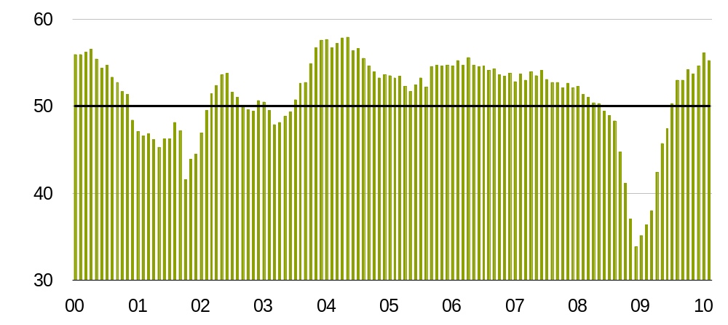
Manufacturing Is Back in Expansionary Territory
Kenneth Colangelo
BB and JPM
JPM Manufacturing PMI SA Index
Updated 3/18
Global Purchasing Managers’ Index
Neutral
Historical analysis does not guarantee future results.
The Global Purchasing Managers’ Index is an indicator of the economic health of the manufacturing sector. The PMI index is based on five major indicators: new orders, inventory levels, production, supplier deliveries and the employment environment.
Through February 28, 2010
Source: Bloomberg and JPMorgan Chase
Notes:
This has been evident in the trend in the global purchasing managers’ index. This is an important indicator, not just for the manufacturing sector, but for the overall global economy.
The index is based on a survey of purchasing managers and their assessment of key aspects of doing business, including overall production, the volume of new customer orders, how fast suppliers are able to deliver materials, and employment levels.
Readings above 50 indicate that business activity is expanding. In fact, the index has been higher than 50 since mid-2009, after recovering from a severe contraction. Historically low inventory levels, improved economic growth and pent up global demand in sectors such as automobiles, have driven this index off of its lows.
Transition: An upturn in manufacturing combined with leaner corporations with lower cost structures, which allow more of their revenues to flow to their bottom lines, has allowed many corporations to build up a significant amount of cash.

Slide 7
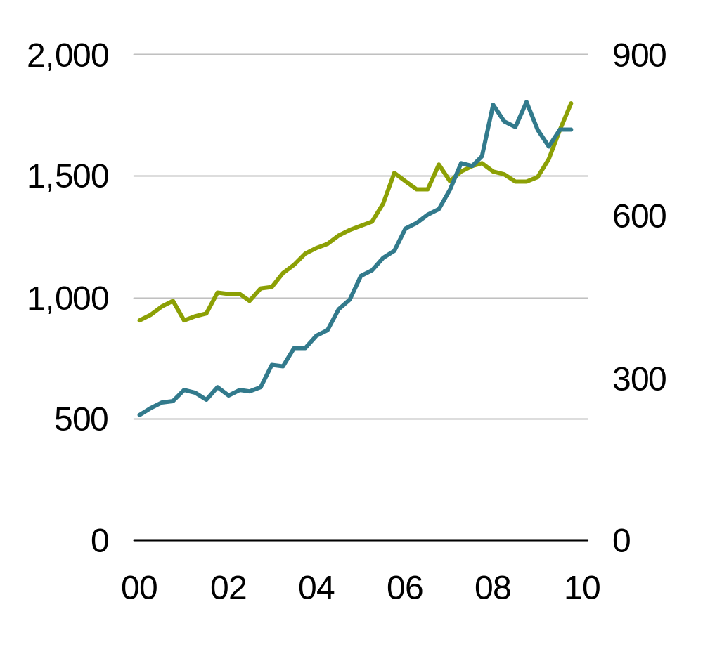
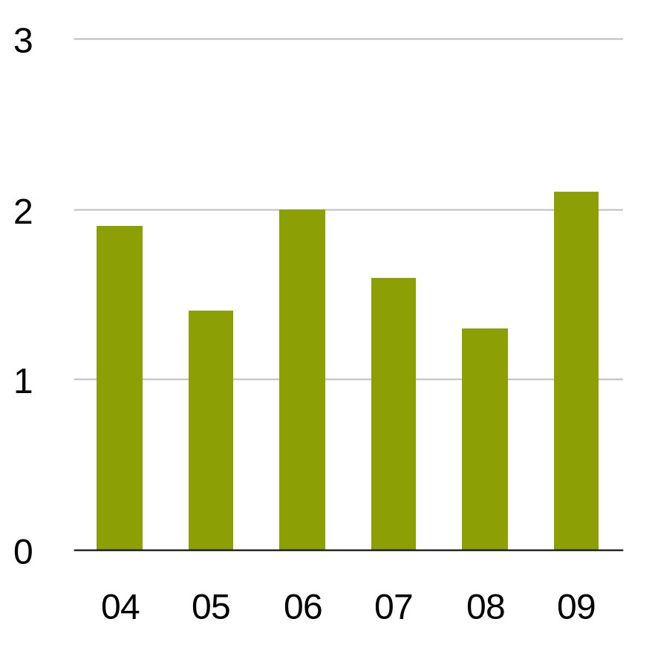
Corporations Are Flush with Cash and Poised to Spend It…
L
UPDATED 9/22
Brian Lomax
Is trying to get 2009 data now (3/17)
R
Lomax
MSCI, BB, Compustat,,Worldscope and AB
Sloane converted
To rolling 3m avg
Free Cash Flow*
MSCI World
Non-Financial Corporations
Total Liquid Assets
US$ Bil.
US$ Bil.
£ Bil.
US
UK
Talking points
Corporate spend—corporations are global in reach, production, materials—so global recovery matters even if an individual country’s growth is lagging
Historical analysis does not guarantee future results.
*Weighted average at year-end.
Please see slide 27 for index definitions.
Source: Bloomberg, Compustat, Morgan Stanley, Worldscope and AllianceBernstein
Notes:
The chart on the left shows the free cash flow of the corporations in the MSCI World Index. This is the cash a company generates after taking care of capital expenditures required to maintain or expand their businesses. It’s higher than it’s been in years, thanks to lower debt burdens and leaner operations.
Clearly, businesses are sitting on a sizable pile of cash and liquid assets, as shown on the right: at the end of 2009, U.S. non-financial companies held total liquid assets of about $1.8 trillion, up more than $400 billion from a year earlier. In fact, more than two-thirds of these liquid holdings are parked in short-term deposits and money market funds, investment vehicles with paltry returns.
U.K.-based firms have also shown a measurable increase in such liquidity over the same time frame, and in both cases, the lines on this graph have been rising for most of the past decade.
Transition: How global businesses ultimately decide to deploy this capital will help define the course of the economic recovery.

Slide 8
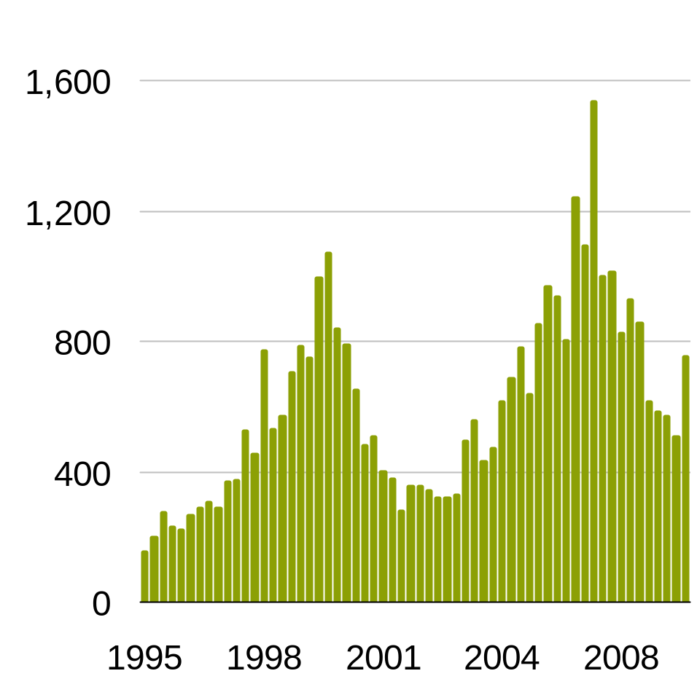
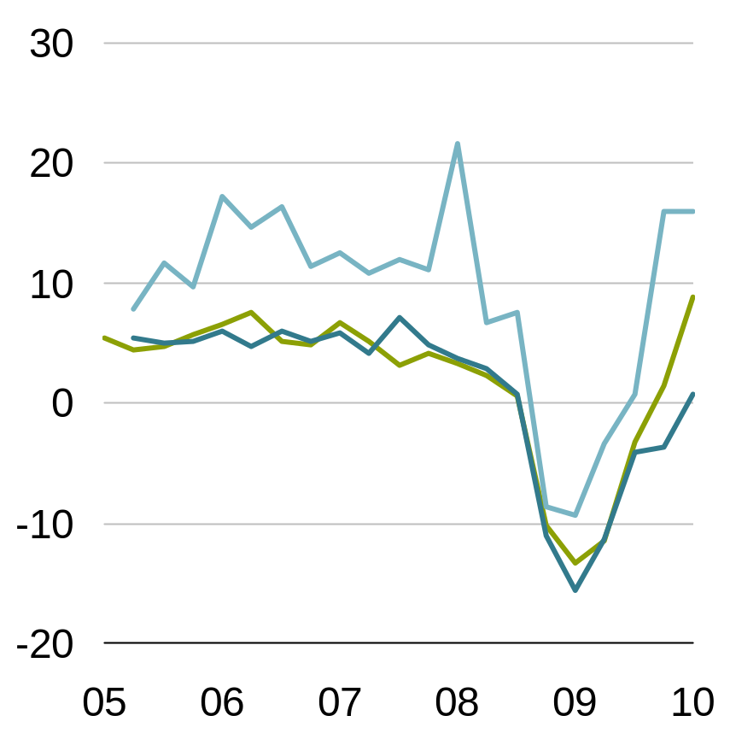
…On Capital Expenditures As Well As Mergers & Acquisitions
    Data (Lomax)
    Source: Dealogic
    Talking points:
    Share buybacks (see Goldman table from Chris) but that’s US centric…. Could show chart showing paid dividends in different regions over time, plus projections in 2010 for dividend swap market… CITE ANECDOTALLY
Expected Growth in Capital Spending*
Percent
Global Mergers and Acquisitions
US$ Mil.
Asia
US
Europe
Historical analysis and current estimates does not guarantee future results.
Left as of March 31, 2010, right as of December 31, 2009
*Next 12 months
Source: Dealogic, Bloomberg, CFO Magazine, Duke University’s Fuqua School of Business, Haver Analytics, JPMorgan Chase and Organisation for Economic Co-operation and Development (OECD)
Notes:
Some businesses are holding onto their extra cash, while others are using it to pay dividends and buy back company stock.
However, a more strategic use of this cash is making capital investments. This is reflected in the chart on the left—capital expenditures are expected to rise substantially over the next year.
We feel that there’s a compelling case for companies to plow cash back into existing operations. First, for many developed-market companies, investment levels are relatively low compared with depreciation. Therefore, they have a strong incentive to invest to offset the obsolescence of existing equipment and machinery. And surging exports could quickly stretch the capacity of many firms, compelling them to invest more cash in productive capacity.
Companies have also allocated cash toward merger and acquisition activities, which have increased from much lower levels during the credit crisis, as shown in the right-hand graph. While M&A is still taking place in fits and starts, it’s an important early sign of confidence on the part of businesses.
Transition: While it’s encouraging to see corporations grow more comfortable in spending on strategic opportunities and initiatives, consumers continue to show a more mixed tone on reaching into their pockets.

Slide 9
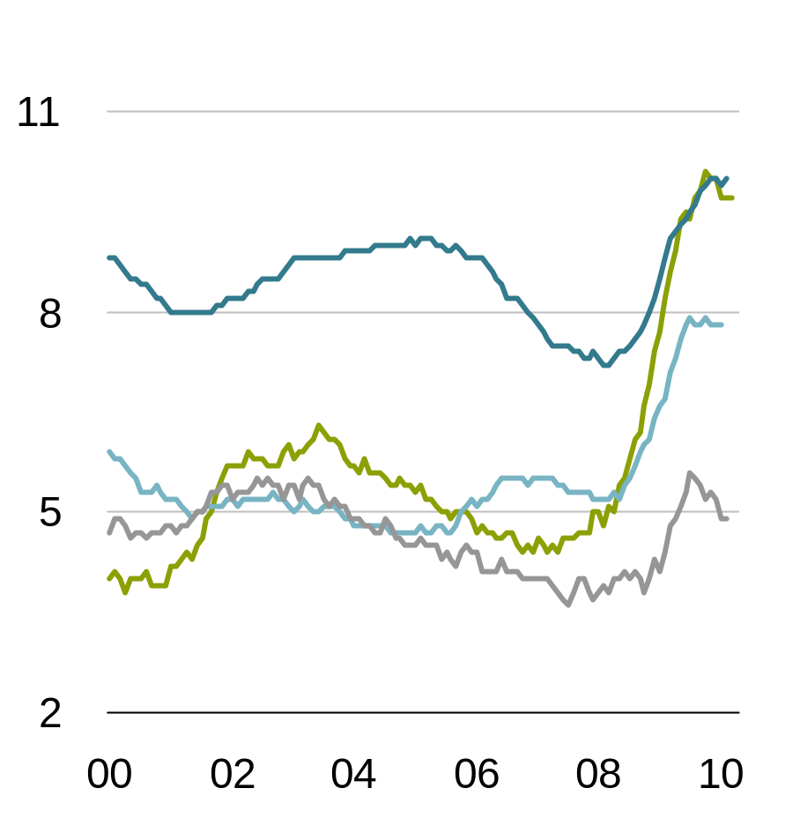
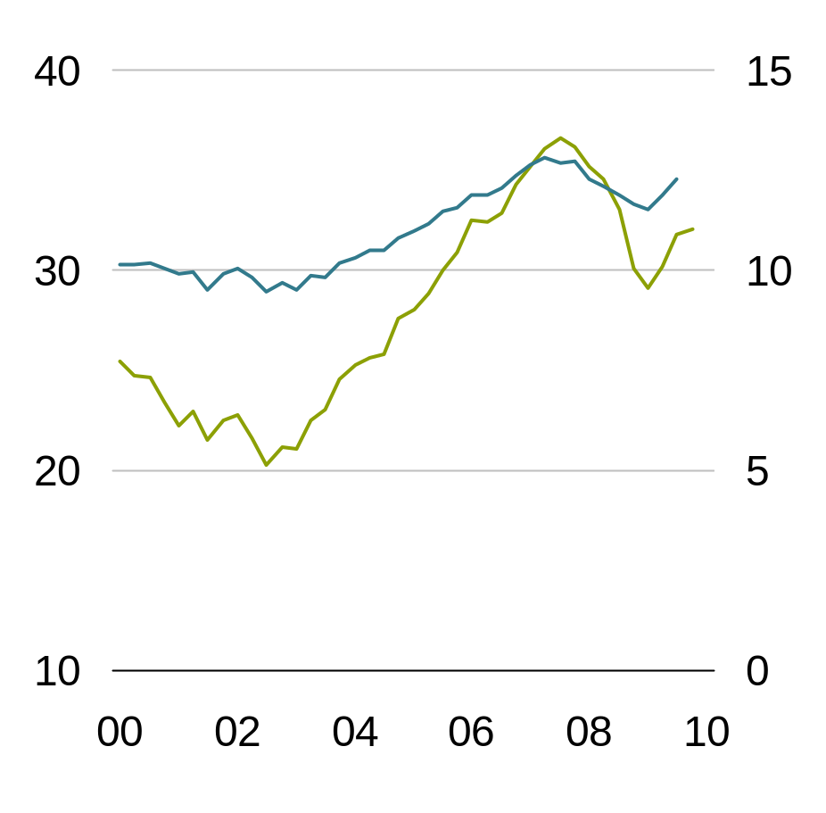
High Unemployment Is Likely Cresting and Assets Are Rising
Lomax, then Sloane
Direct sources
Updated 3/12
Unemployment Rate
Percent
Household Liquid Assets
US$ Tril.
€ Tril.
Euro Area
European Union
UK
US
US
Japan
Historical analysis does not guarantee future results.
UK data through December 2009; euro area and Japanese data through January 2010; US data through February 2010
Seasonally adjusted
Source: Eurostat, Statistics Bureau of Japan, UK Office for National Statistics, Haver Analytics and US Bureau of Labor Statistics
Notes:
As you can see in the left-hand graph, stubbornly high unemployment is one reason for the caution. However, we feel that this painful period for job seekers is cresting.
We’re seeing signs of a classic pattern of labor-market improvement. As recoveries become more entrenched, demand picks up and businesses are stuck with lean inventories…and lean work forces. Businesses squeeze more production out of fewer workers by extending work weeks, and step up their efforts to hire temporary workers…often a precursor to permanent hiring. These trends are appearing now…eventually, you can only stretch so much, and businesses have to start hiring permanent workers.
Helping to offset the unsettled employment landscape is the improvement in the net worth of many individuals, aided by a powerful advance in the capital markets over the last year. You can see this in the chart on the right, which shows an increase of Household Liquid Assets numbering in the trillions. (These assets include cash, demand deposits, credit market instruments and mutual funds).
Transition: An improving employment picture, coupled with a more financially-healthy consumer, should ultimately lead to higher levels of consumer spending. And we are seeing some signs of this occurring.

Slide 10
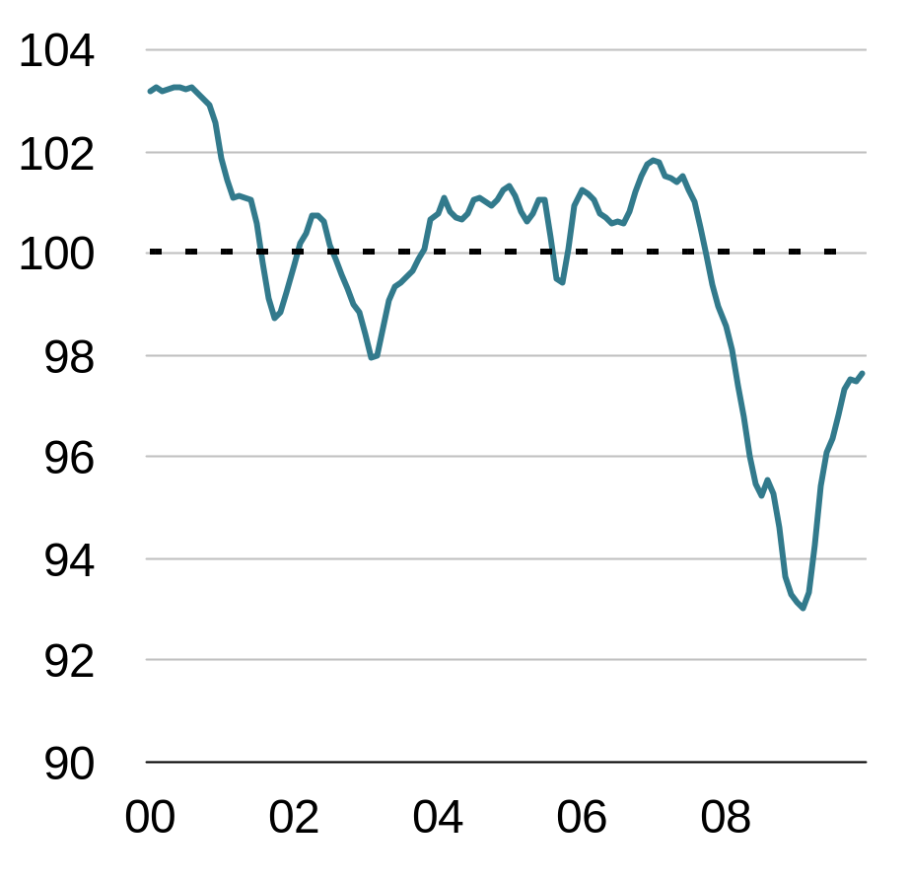
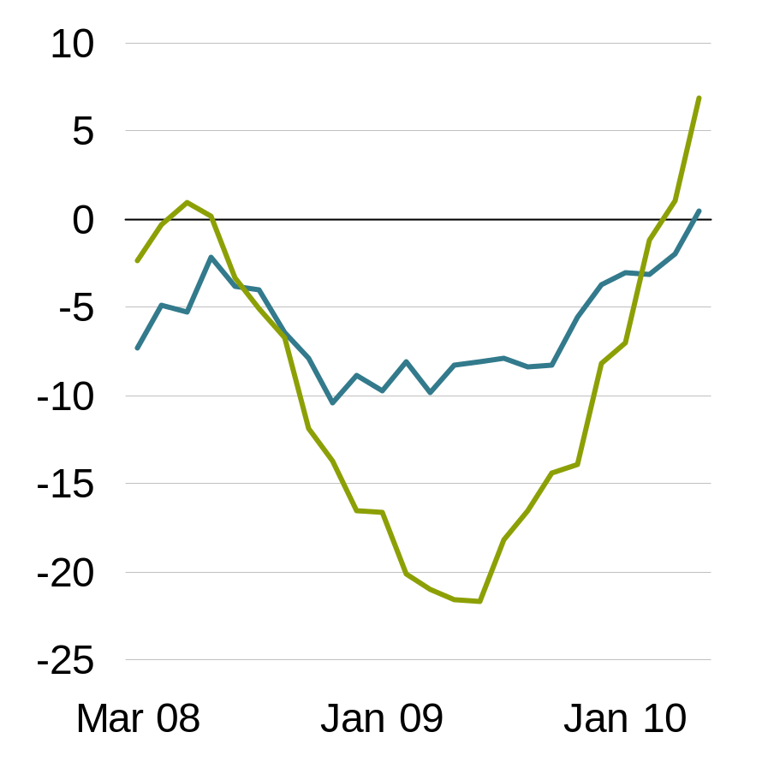
Don’t Count the Developed Consumer Out
G7 Consumer Confidence Measures
US Same-Store Sales
Year-over-Year % Change*
L: personal savings rate
Colangelo
UK source is Haver and UK office for nat stats
US source is Haver and BEA
UPDATED 3/18
R; retail sales starting to come back
Source is the stores plus Citi
Rob Ryman
Can we get seom historical comps
On the savings data? Sloane to check
Luxury
Neutral
Middle Tier
Historical analysis does not guarantee future results.
Left as of December 31, 2009; right as of January 31, 2010
*Rolling three-month average through February 28, 2010; middle tier comprises Dillard’s, JCPenney, Kohl’s and Macy’s; luxury comprises Neiman Marcus, Nordstrom and Saks Fifth Avenue.
Source: Organisation for Economic Co-operation and Development (OECD), Citigroup, Dillard’s, Haver Analytics, JCPenney, Kohl’s, Macy’s, Neiman Marcus, Nordstrom, Saks Fifth Avenue, UK Office for National Statistics and US Bureau of Economic Analysis
Notes:
The survey numbers you see on the display on the left, reflect the confidence level of consumers in the G-7 developed nations (US, Canada, UK, France, Germany, Italy and Japan).
Now, I certainly wouldn’t call these numbers optimistic, but they have improved steadily from the height of pessimism in early 2009. And confidence can be a critical element for consumer spending, since it leads them to spend money on new cars, new appliances, vacations, entertainment and other activities that help underpin economic growth. But confidence measures don't always closely track consumer spending patterns.
While confidence measures overall remain tepid, and savings rates have increased from their low levels in key developed economies such as the U.S., we shouldn’t count developed consumers out of the spending picture yet. The chart on the right clearly shows that these consumers are beginning to shop again. It seems that the adage, “Watch what they do, not what they say”, might apply here.
Luxury-store sales have posted year-over-year gains since mid-2009, and those who shop at these stores tend to be upper-income consumers with highly discretionary preferences. But we’re also seeing a more gradual recovery in the sales of middle-tier store chains, too.
Transition: These trends gives us confidence that developed households may soon be stepping up their contributions alongside emerging markets, giving the consumer spending recovery greater breadth than it’s had to this point.

Slide 11
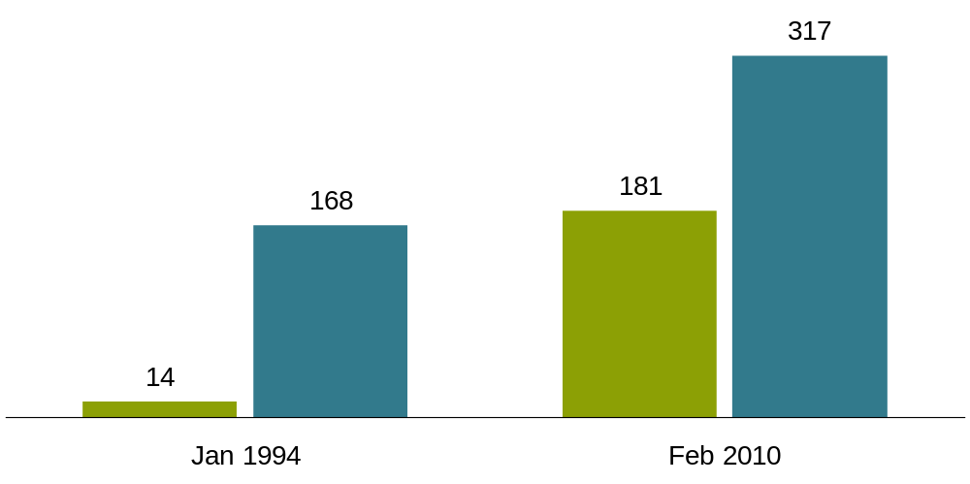
Emerging-Market Middle Class Leads Consumption
Anthony Chan
Updated 3/29
Real Retail Sales
USD Billions
China
US
Compound Annual Growth Rate
1994–2009
US 4.0%
China 17.7%
Historical analysis does not guarantee future results.
Data represent real retail sales for the month shown.
Source: CEIC Data
Notes:
It’s the growing middle class in emerging markets that has been a major catalyst for rebalancing global consumption, and China serves as a prime example. With such extremely rapid consumption growth, China continues to close the gap with the United States. You can see the progress in this chart, which shows real retail sales in both countries.
Fifteen years ago, China’s retail sales were almost nonexistent in comparison with $168 billion in US sales. But growing wealth is translating into more shopping trips for China’s growing consumer base. This has fueled annualized sales growth of almost 18% over that time span. That’s more than four times the pace of US sales growth, and that’s considering that China still has one of the world’s highest personal savings rates.
Transition: The products that consumers in China and other emerging markets are picking up on those shopping trips should seem very familiar to consumers in the United States and other developed markets.

Slide 12
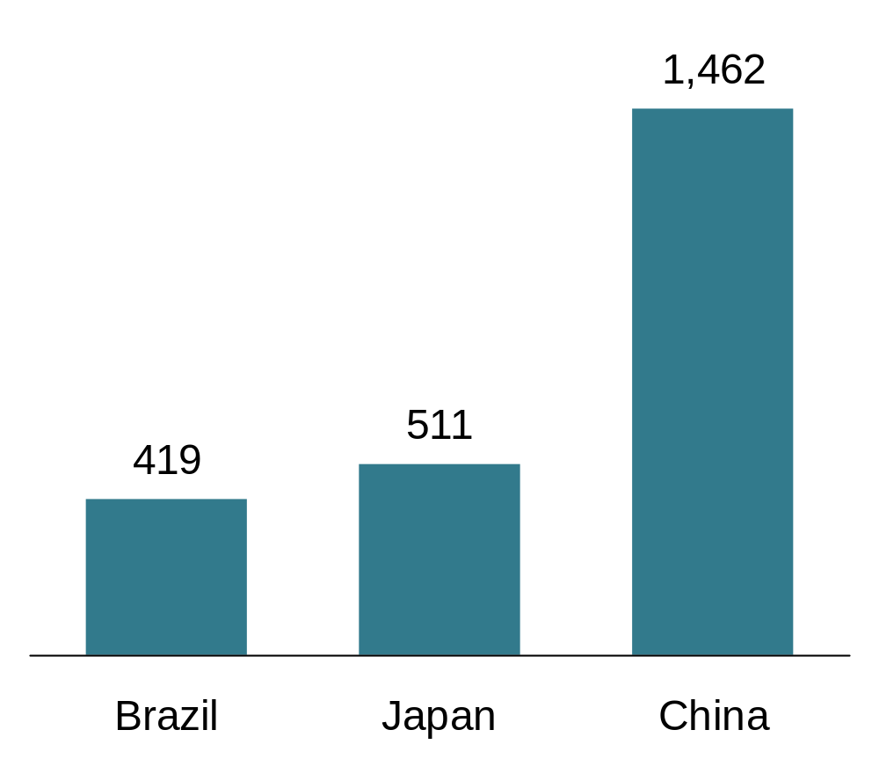
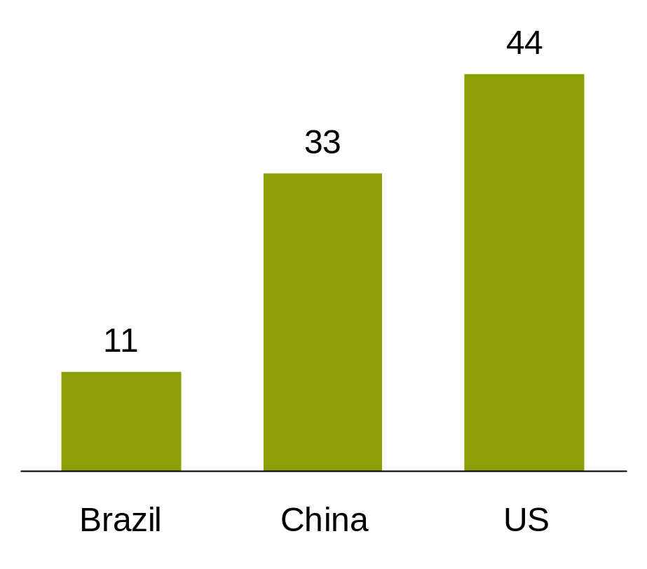
Emerging-Market Consumers
Buying a Wide Range of Products
Rajeev Eyunni
Sales=Euromonitor
Acc’g to Euromonitor,
China will overtake the US in total
Sales of TVs in 2010
Is 2009 data available yet?
R Financial Times
2008 Sales of TVs
Millions of Units
2009 Stock of Western-Built
Passenger Jets*
1) Total Sales (source Euromonitor, we are still rechecking the nos as Euromonitor sometimes has dodgy data).
a) 2008 sales of TVs (mn units) - China (32.976), India (14.361), Brazil (10.968) Vs. the US (44.145). According to Euromonitor China will overtake the US in 2010.
b) 2008 sales of Refrigerators (mn units) - China (27.884), India (1.953), Brazil (2.632), Russia (3.764) vs. the US (9.310)
Historical analysis does not guarantee future results.
*Number of aircraft in service and storage
Source: Euromonitor International, Financial Times and AllianceBernstein
Notes:
Among the items they’re buying are cars, cell phones, TVs and refrigerators.
On the left-hand chart are 2008 purchases of TVs. Brazil and China together were about the same size as the US market. We expect these consumption levels to continue to increase, fueling additional sales. The impact will be sizable.
And emerging market consumption isn’t restricted to items that individuals can fit into a living room or kitchen. Brazil has nearly as many Western-built passenger jets as Japan—and China’s fleet is about three times the size of Japan’s.
As consumption in emerging markets continues to grow, world consumption should become more balanced. And we believe that’s a good thing for the global economy.
Transition: It’s also a good thing for the countries providing these goods. Increasingly, the suppliers are companies based in developed economies such as the United States and Europe.

Slide 13
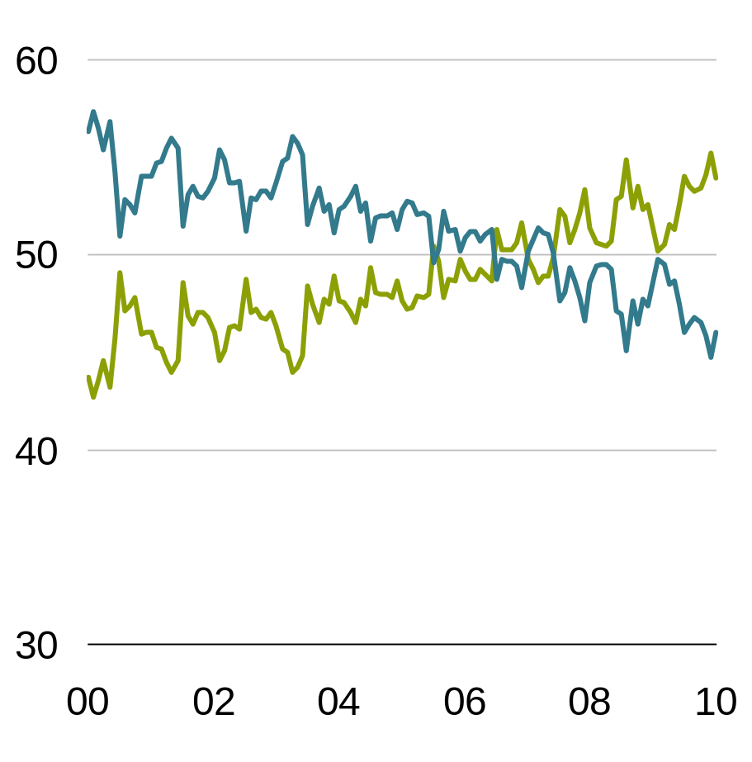
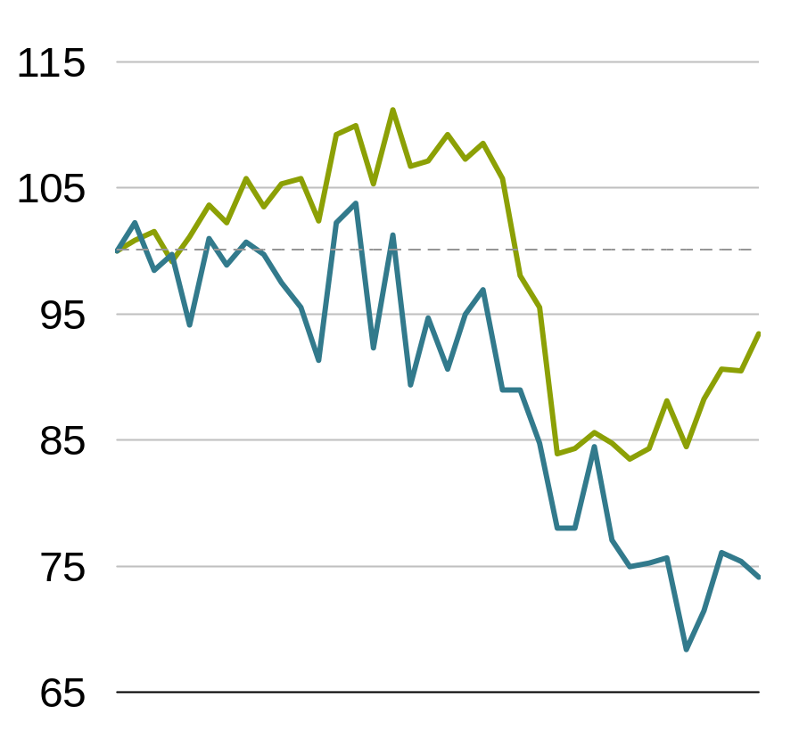
Developed-Market Exports
Are Increasingly Headed for Emerging Markets
What US export (to all markets):. Top four are:
Transportation equipment
Basic chemicals
Computers and electronics
Machinery
Distribution across EM is very broad. US exports sent to em has risen from 47% in 2002 to 55% in 2009.
Destinations for US Goods Exports Percent of Total
Euro-Area Goods Exports*
Index
Emerging Markets
L:
Carson (US)
Census Bur,
Haver
Updated 3/25
R Williams. Haver and AB
For talking points see Williams’
Feb 26 weekly
Asia
Industrialized
Countries
Total
they’ll be buying things from US, etc.
  combination of weaker dollar and two decades of restructuring has made the US actually a very competitive place for manufacturing (Joe may have done something on this—Sloane to look)—the US is exporting
  Can we find something for Europe that works well too?
2007
2008
2009
Historical analysis does not guarantee future results.
Left through January 31, 2010; right through December 31, 2009
Emerging Markets include Latin America, Asia ex-Japan, Emerging Europe, the Middle East and Africa. Industrialized Nations are those countries not included in the Emerging category.
*Export data indexed at 100 at January 2007.
Source: Haver Analytics, US Census Bureau and AllianceBernstein
Notes:
Focusing on the U.S. for a moment, a combination of a weak dollar and extraordinary productivity gains has made US goods much more competitive to consumers in emerging markets. The results can be seen in the left display.
U.S. exports have risen steadily since the early 2000s, and over the last few years, exports to emerging countries have flipped from a minority to a majority; rising from roughly 44% of US exports in the beginning of 2000 to about 54% at the close of 2009.
On the right-hand side is the corresponding chart for the euro area...over a shorter time frame than the US data. Euro exports to emerging markets had been falling in recent years, but they’ve stabilized recently. As you can see, exports to Asian markets are the primary reason.
Transition: Booming U.S. exports to fast-growing emerging markets, rebounding business investment and accelerating productivity gains are helping to offset smaller contributions from the traditional growth engines of consumer and housing sectors, particularly in the U.S. This “new mix” of drivers for U.S. companies shouldn’t be overlooked by investors.

Slide 14
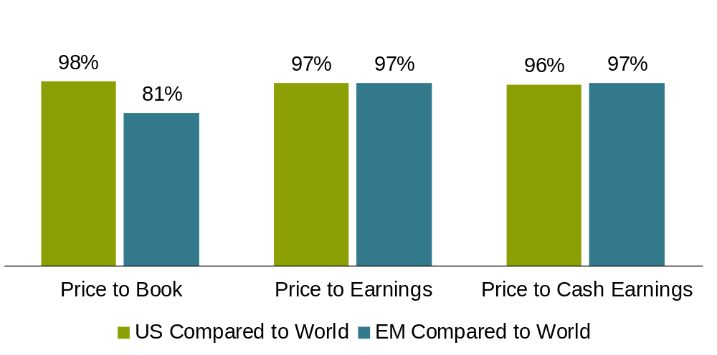
US Valuations Aren’t Stretched, and Opportunities Appear to Remain in Emerging Markets
Current Valuations Relative to
10-Year Average Valuations
Historical analysis and current estimates do not guarantee future results.
US, EM and World are represented by MSCI US, MSCI Emerging Markets, and MSCI World Indexes, respectively.
100% means that current valuations are in line with long-term average relative valuations, less than 100%indicates a discount, greater than 100%indicates a premium.
As of February 28, 2009
Source: Barclays, Thomson I/B/E/S, MSCI, and AllianceBernstein analysis
Notes:
Despite the favorable outlook for US companies, market valuations are in line with their long term averages versus the rest of the world. We’ve compared their prices on a Price/Book, Price/Trailing Earnings and Price/Cash Earnings basis. By these measures, they remain reasonably priced, despite the extended equity rally from the market bottom.
There’s a similar result for Emerging-Market equities, but they’ve historically traded at a discount to developed equity markets, given their traditionally higher, relative volatility.
In our view, the best way to capture opportunities in these asset classes is through a research-based approach, since there can be a big difference between winners and losers. Investors who are underweight these stocks, many of which are domiciled in some of the world’s most dynamic economies, risk missing out on a rare opportunity—especially when it comes to U.S. stocks. We believe investors can benefit from faster profit growth without having to pay a premium.
Transition: While we see fertile opportunities in these and other equity segments, recent capital flows seem to show that investors remain skeptical about stocks.

Slide 15
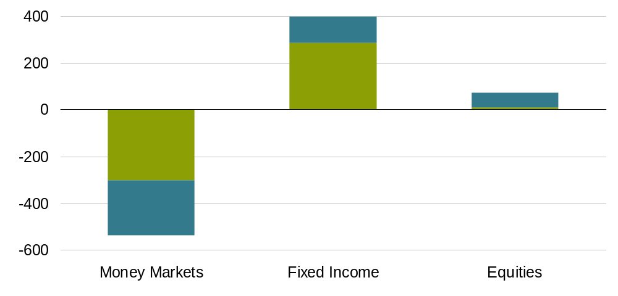
Investors Are Moving Away from Cash
2009 US Net Mutual Fund and ETF Flows
US$ Bil.
        Shift from money markets into core credit, so improving but muted
        Brian requested this from Goldstein
Retail
Institutional
Historical analysis does not guarantee future results.
Money market, fixed income and equity categories as defined by Strategic Insight and the Investment Company Institute.
As of December 31, 2009
Source: Empirical Research Partners, Investment Company Institute and Strategic Insight Simfund
Notes:
As you can see from this slide, many investors have migrated away from cash and began to look toward other asset classes, based on net investment flows into mutual funds and ETFs for 2009. To date, they’ve been relatively cautious about where this money is headed.
Cash flows have largely moved from lower-yielding money-market investments into fixed-income investments. 2009 net flows into bond funds were roughly four times the level of equity inflows, with credit sectors like corporate bonds and high yield among the beneficiaries.
Conversely, transfers into equity funds have been muted—and dominated almost exclusively by institutional investors. Individual investors, on the other hand, have been more reluctant to jump back into the deep end of the pool and embrace stocks again.
Transition: So for the most part, flows to date have overlooked equities, where corporate profitability appears to only be starting to recover.

Slide 16
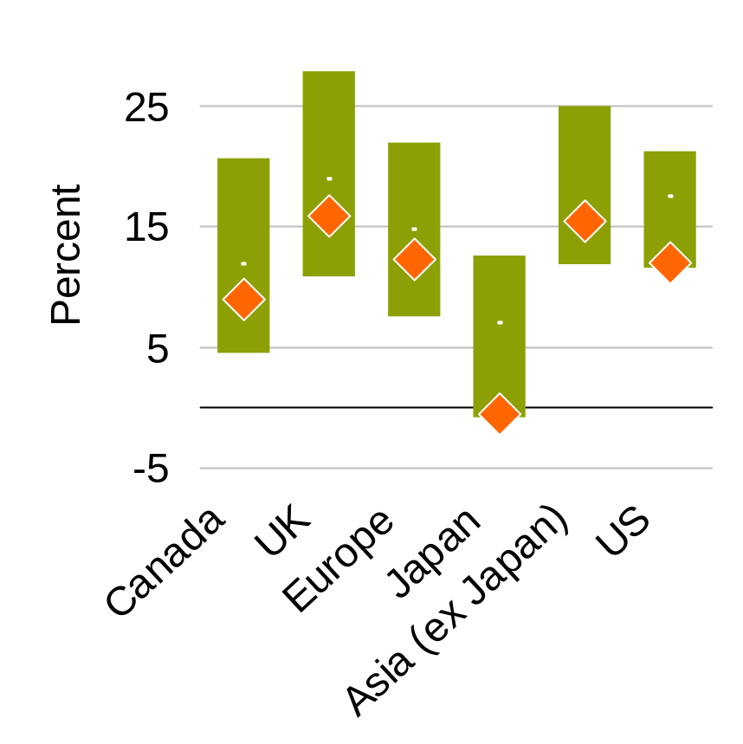
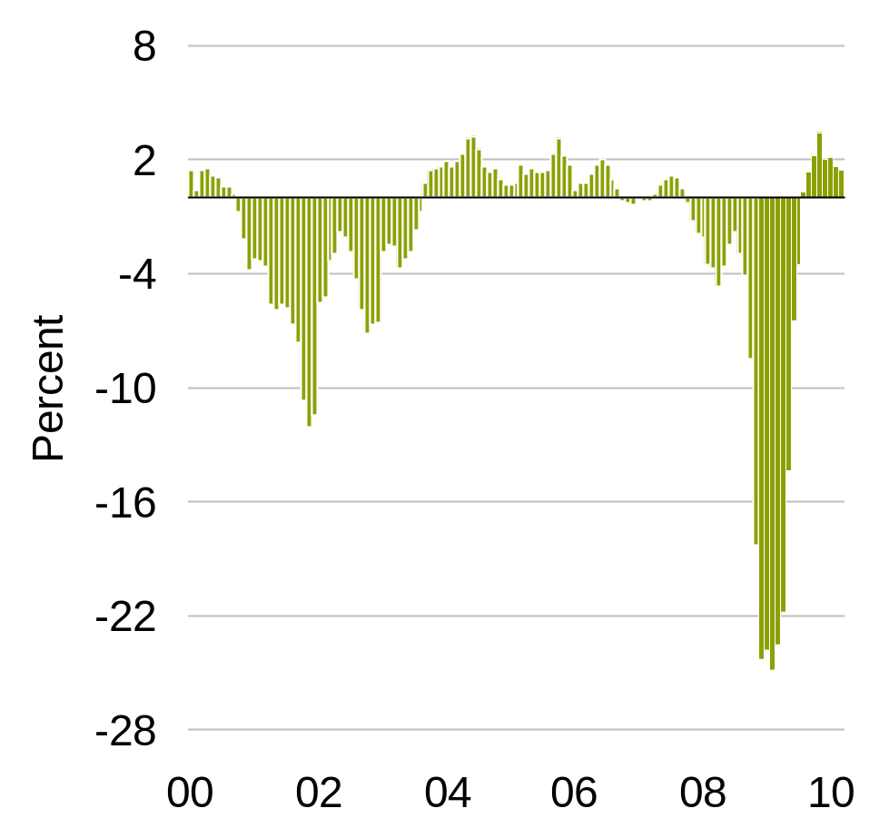
Profitability Is Rising and Earnings Revisions Have Been Positive
A. Walther
Updated 3/22/10
Thomson I/B/E/S Aggregates
One Month % Change NTM
Developed World
Return-on-Equity by Region*
MSCI World Index Earnings Revisions
Rolling Three Months**
Range
Average
Current Level
Historical analysis does not guarantee future results.
*Capitalization-weighted historical range, average and current level; 1986 through late February 2010
**As of March 22, 2010, based on aggregate estimates; represents change from previous month in estimates for next 12 months
Source: Empirical Research Partners Analysis, FactSet, MSCI (see slide 27 for index definition), Thomson I/B/E/S and AllianceBernstein
Notes:
We’re seeing profitability just begin to rebound from its recent cyclical lows, and it’s been happening globally.
The left-hand chart shows various regions with low profitability, as measured by return on equity (ROE). We don’t think this is sustainable. In 2010, ROEs have finally begun to turn upward. They remain far from their previous peaks, but we believe we’re at the turning point of the corporate earnings cycle…and the market hasn’t yet caught up with the forward-looking profit picture.
You can see this lag in the right-hand graph, which shows that earnings revisions are still positive. Another encouraging sign is that earnings improvements had been driven mostly by cost-cutting and bottom-line improvements, but in recent quarters we’re seeing improvements in the “top-line”—a recovery in revenues that signals renewed economic activity and increased demand.
Transition: With these revisions for earnings and revenues turning positive, it provides more evidence that analysts see earnings gains ahead.

Slide 17
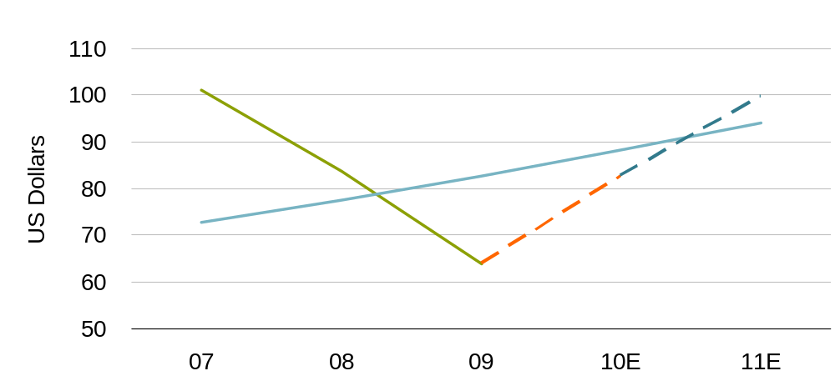
As Earnings Recover, Valuations Look More Attractive
MSCI World Operating Earnings per Share
Awalth
UPDATED 3/22
2011 Consensus
Earnings Growth
20%
Trend
2010 Consensus
Earnings Growth
30%
Price to Forward Earnings: 18.7× 14.4× 12.0×
Historical analysis and current estimates are not a guarantee of future results.
Actual earnings through December 31, 2009; 2010–2011 consensus estimates as of March 18, 2010
Source: FactSet, MSCI, Thomson I/B/E/S and AllianceBernstein
Notes:
As of now, the consensus expects earnings growth of 30% in 2010 and 20% in 2011. On the basis of those forecasts for future earnings, stocks actually look quite attractive based upon 2010 and 2011 earnings. [You can see that in the P/E ratios along the bottom of this chart].
Transition: So in light of this, how do we assess the current, equity investing landscape?

Slide 18
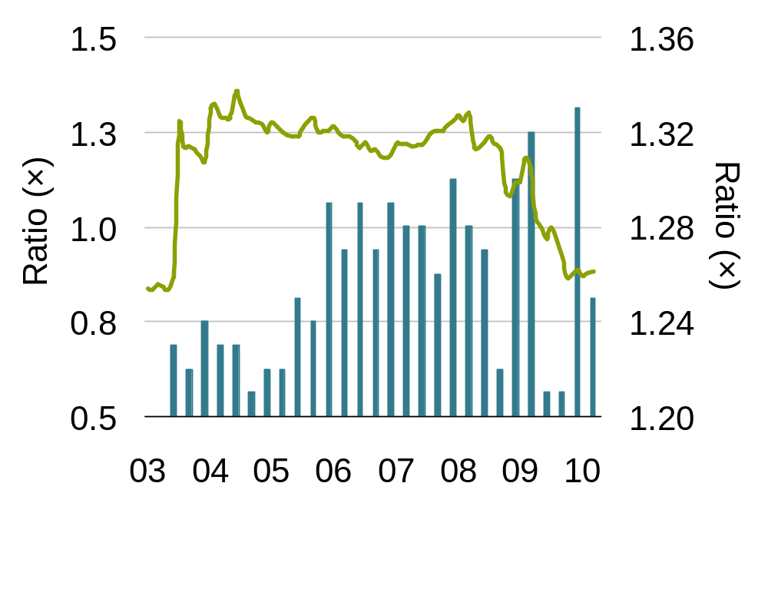
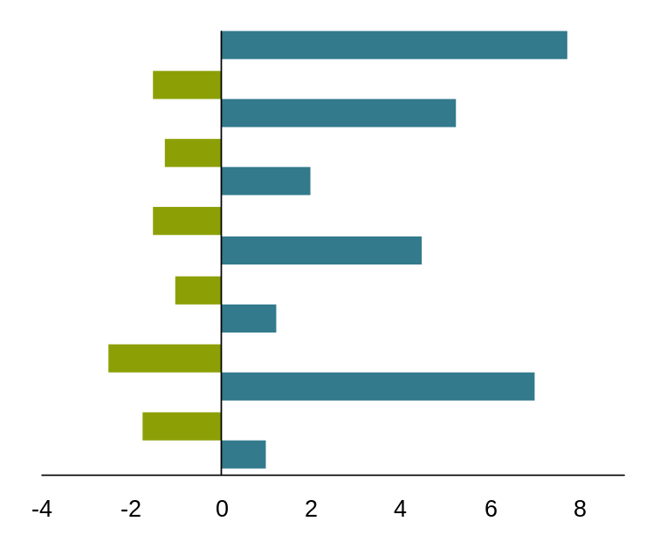
Broad Opportunities Remain in Equities, Despite Rebound
Duration of Value Cycles
(1971–2009)*
MSCI World Growth vs. MSCI World
Value Cycles
Underperformance of
Low P/B and P/E
Outperformance of
Low P/B and P/E
Start Date
1
Dec 1971
Sep 1979
Mar 1981
Jun 1986
Sep 1987
Sep 1989
Mar 1991
Sep 1995
Sep 1996
Dec 1997
Jun 2000
Jun 2007
Mar 2009
2
3
Average = 1¾ years
4
Average = 4¾ years
5
6
7
4
2
Relative P/E (Left Scale)
No. of Years
Relative Long-Term EPS Growth**
Past performance is not a guarantee of future results.
As of March 31, 2010
*Value cycles defined as at least three quarters of rolling one-year outperformance or underperformance of combined price/book value and price/earnings factors versus the MSCI World Index hedged into USD
**Based on aggregated analysts’ consensus forecasts for long-term EPS growth
Source: CRSP, FactSet, MSCI, Thomson Datastream, Thomson I/B/E/S, Bernstein and Alliance
Notes:
Over time, opportunities tend to be greater in one style or the other. Sometimes value stocks offer greater potential, and sometimes growth stocks do. A positive byproduct of the terrible 2008 sell off was that it created broad-based opportunities in both styles, and we feel this condition remains intact.
Regarding value stocks, we feel we’re still in the early stages of a strong cycle for these companies, as shown on the left-hand graph. It shows seven value cycles dating back to 1971. During these periods, the cheapest stocks in our global value universe (as measured by Price/Book and Price/Earnings) both outperformed (the blue bars) and underperformed (the green bars) at different times.
The chart also shows the average duration of the outperformance and underperformance of this subset of stocks. Underperforming periods lasted 1 ¾ years on average, while outperformance periods lasted 4 ¾ years on average. Considering that this set of our cheapest value stocks began outperforming in March 2009, we feel this cycle has time on its side.
Turing to growth stocks, the display on the right shows the relative long-term earnings of the MSCI World Growth Index companies compared to the overall MSCI World Index Index, in the blue vertical bars. Growth firms have superior earnings growth relative to the broad index, but you can own them at a discount to the overall index. This isn’t normal—typically, investors must pay a premium when this situation exists.
Transition: So, we continue to find broad opportunities in global equities. Now, let’s turn to fixed income, and we’ll start by looking at interest rates.

Slide 19
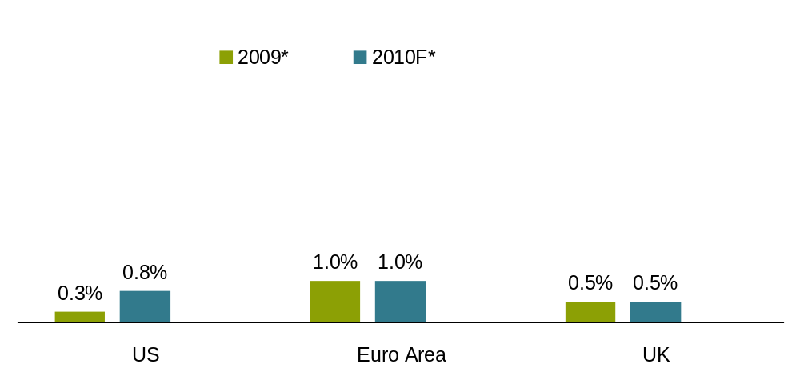
We Expect Short-Term Rates to Rise
Carson
Updated 3/15
AB
Bloomberg
Official Interest Rates
1998–2007
4.9%
3.7%
3.1%
Historical analysis and forecasts do not guarantee future results.
Projections may not come to pass.
As of June1, 2010
*At year-end; 2010 forecasts are AllianceBernstein’s.
Source: Bloomberg and AllianceBernstein
Notes:
We feel that as the economic recovery becomes more entrenched, policymakers will continue to roll out their exit strategies—removing the unprecedented support provided to the economy and markets.
As they do this, we expect short-term rates to rise. Historically, there’s been a strong correlation between rising economic growth and interest rate increases. Central banks like to “take away the punch bowl” as economies heat up to guard against inflation. But the key is the pace and extent of the rate increase. We think central bankers have a lot of room in which to maneuver.
Here you see the current official rates in several of the world’s economies, along with our forecasts for year-end 2010—in dark blue. Clearly, we expect rates to move higher, with the federal funds rate rising as high as 2% in the US.
But rates will be rising from very low levels compared to history, as you can see from the pale blue bars representing the decade from 1998 through 2007. Remember, we had very strong growth in that decade, even with rates much higher than where we expect them to be at the end of this year.
Transition: However, keeping inflation under control will be a high priority among policy makers.

Slide 20
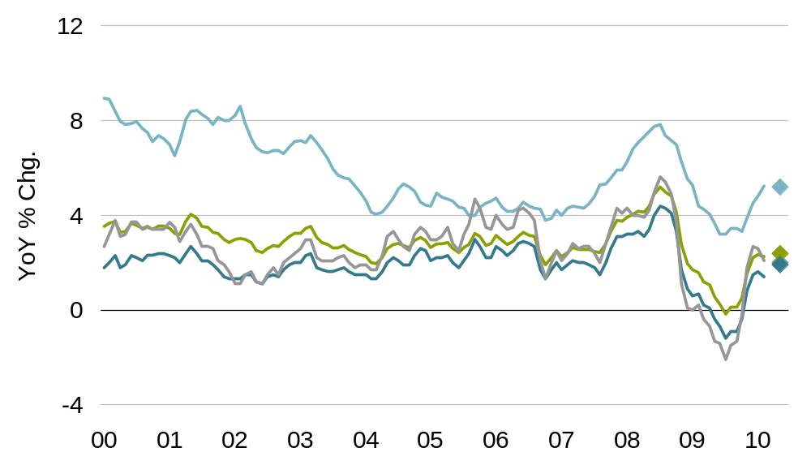
Inflation Appears Contained
Headline Inflation
Emerging Markets
2010 Inflation Forecasts:
EM 5.2%
Global 2.4%
US 2.0%
Industrial. 1.9%
Global
Industrialized Countries
US
Historical analysis and forecasts do not guarantee future results.
Data as of February 28, 2010. Alliance Bernstein inflation forecasts as of June1,2 010.
Source: Bloomberg, CPB Netherlands Bureau, Haver Analytics and AllianceBernstein
Notes:
This chart shows headline inflation rates for various economic regions going back to the start of this decade, along with our 2010 inflation forecasts for these territories.
Inflation has risen from early last year’s lows, mainly due to rising food and oil prices. However, core inflation numbers (which exclude food and energy prices due to their high volatility) have been well contained.
And our near-term stance on core inflation remains that it’s not a threat. A combination of ample spare capacity in industry, constrained wages and a decline in private credit growth have so far offset the higher prices of food and energy globally.
However, massive monetary and fiscal stimulus have many concerned that inflation could rear its ugly head at some point. Higher inflation could lead to higher prices for consumers and businesses alike, plus an erosion of investor’s capital. Clearly, inflation is a variable central bankers and investors will—and should—be focused on as they monitor the character of the economic recovery.
Transition: Since we believe that short-term rates are likely to rise to counteract inflation expectations and pressures, what can bond investors do to help position themselves for such an environment?

Slide 21
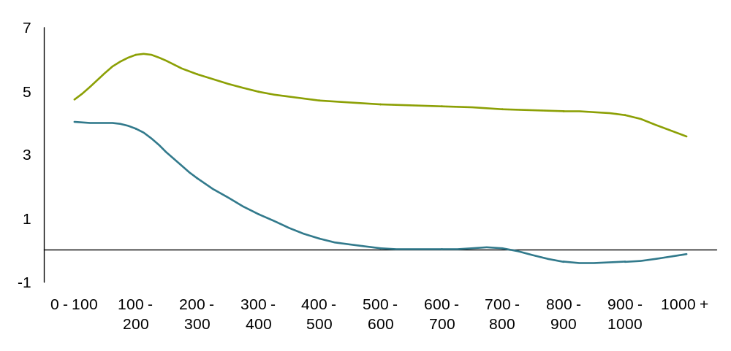
Bonds with Higher Yield Spreads Are Historically Less Sensitive to Rate Changes
Corporate Bond Yield Spreads and Duration
More Sensitive to
Changes in Interest Rates
Less Sensitive to Changes
in Interest Rates
Stated Duration of Bond
Duration (years)
Experienced Duration of Bond
Spread (b.p.)
Past performance and current analysis do not guarantee future results.
Corporate bond data shown is for US investment grade and high yield bonds issued by corporations.
Duration is a measure of the sensitivity of an asset or portfolio’s price to interest rate movements.
Source: Barclays Capital and AllianceBernstein
Notes:
With rising short-term interest rates, people are naturally concerned about duration risk in their portfolios—the sensitivity of their bond prices to changing interest rates. But not all durations are created equal…this research suggests that duration matters less when the yield advantage, or yield spread, of bonds is larger.
Here’s an example of duration calculated for corporate bonds with different spreads. The green line at the top is the stated duration…simply the mathematical calculation of a bond’s interest-rate sensitivity based on its maturity, coupon, yield and how often the coupon is paid.
However, corporate bonds don’t move in lock-step with the Treasury bond market…in investing terminology, they’re not perfectly correlated. Since they’re exposed to credit factors, they’re not driven exclusively by changes in interest rates. As a result, the actual sensitivity that these bonds exhibit when rates move is actually much less than the math implies—you can see that in the green line, which shows the actual sensitivity experienced by the bond.
Moving from left to right, the larger the yield spread, the lower the experienced duration...meaning that these bonds are less sensitive to movements in US Treasury rates than you’d expect. And when a bond’s spread is higher than 500 basis points, or 5%, it acts as if it’s not sensitive to interest rate movements at all!
Not all duration is as 'bad' in a rising rate environment as investors may fear. It’s important to look carefully at the source of duration in mutual funds in order to get a true sense of its vulnerability to riding rates.
Transition: Another way to help reduce exposure to changes in interest rates is to diversify globally.

Slide 22
Why Global? Because No Country Wins All the Time
USD Hedged
Fixed-Income Country Returns
Percent
2000
2001
2002
2003
2004
2005
2006
2007
2008
2009
2009
Best
Australia
13.7
Japan
7.5
US
Treasuries
11.8
Canada
4.1
Euro Area
6.9
Canada
7.5
Japan
5.3
US
Treasuries
9.0
Australia
15.1
Euro Area
4.1
US
Treasuries
13.5
Canada
7.2
Euro Area
8.2
Euro Area
3.1
Canada
6.2
Euro Area
6.5
Canada
4.6
Japan
7.8
US
Treasuries
13.7
Japan
1.4
Canada
11.5
US
Treasuries
6.7
Canada
7.4
US
Treasuries
2.2
US
Treasuries
3.5
UK
6.4
US
Treasuries
3.1
Canada
5.7
Canada
11.7
UK
-1.6
Euro Area
9.5
Euro Area
5.5
UK
7.2
Japan
0.3
UK
3.5
Japan
4.1
Euro Area
1.8
UK
4.7
UK
10.4
Canada
-1.9
UK
9.2
Australia
3.1
Australia
6.3
UK
-0.3
Australia
3.1
Australia
3.4
Australia
1.2
Euro Area
3.1
Euro Area
8.4
US
Treasuries
-3.6
Japan
8.5
UK
2.1
Japan
5.3
Australia
-0.8
Japan
2.7
US
Treasuries
2.8
UK
0.9
Australia
2.0
Japan
6.7
Australia
-5.9
Worst
Gap between best
and worst
5.2
5.4
6.5
4.9
4.2
4.7
4.4
7.0
8.4
10.0
Past performance does not guarantee future results. These returns are for illustrative purposes only and do not reflect the performance of any fund. Diversification does not eliminate the risk of loss.
Returns represented by respective Barclays Capital country bond indices. An investor cannot invest directly in an index or average and they do not include sales charges or operating expenses associated with an investment in a mutual fund, which would reduce total returns. Please see slide 27 for index definitions.
Source: Barclays Capital and AllianceBernstein
Notes:
Bonds from different countries, for example, don’t always rise or fall in lockstep, because economic policies and cycles around the world vary.
Take the euro area, for example. Its bond returns were among the best in the developed world from 2002 to 2005. But Japan led in 2006. Since different countries follow distinct paths, a global bond allocation can be a powerful source of diversification against interest-rate risk.
Another item to note on this chart is that the price of placing all of your bond capital in the wrong market can be high. This is evident as you look at the numbers in the bottom row, surrounded by the red rectangle, which highlight the difference between the best and worst performing regions. (Look especially at the last three years).
Transition: To this point, we’ve addressed strategies and opportunities in taxable bonds. But concerns about rising rates also apply to municipal bond investors, and there are several strategies to consider.

Slide 23
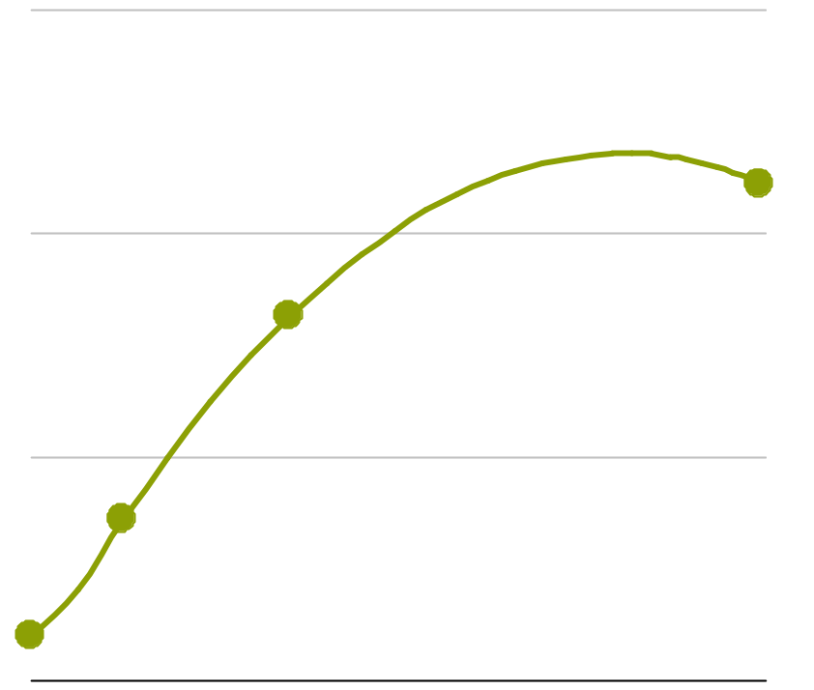
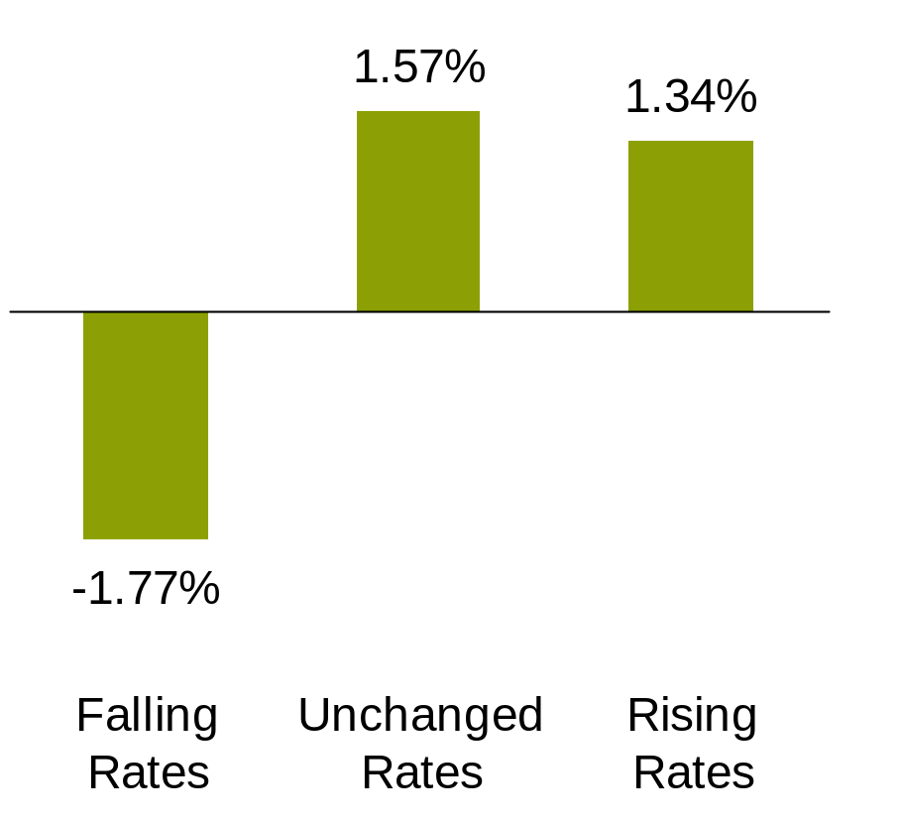
Intermediate & Lower-Rated Municipals
Appear To Be Attractive
Davidson or
Matt Norton
UPDATED 1/21
Relative Performance Under
Various Fed Regimes
BBB-Rated vs. AAA-Rated Bonds**
Municipal Market Expected Returns*
4.4%
VISCOM: Make build, left chart first, then right chart on click
3.3%
1990–2009 Average Expected Return Advantage =
1.9%
1.4%
2.9%
more than cash
0.4%
Cash
Short
Intermediate
Long
Past performance does not guarantee future results. Forecasts may not be obtained.
Left as of March 31, 2010. Right analysis was performed for period January 31,1988 to December 31, 2009.
*For AA-rated bonds
**Credit quality is a measure of the quality and safety of a bond or portfolio, based on the issuer’s financial condition. AAA is the highest (best) and D is the lowest (worst).
Source: Municipal Market Data Corp., Securities Industry and Financial Markets Association, US Treasury Department and AllianceBernstein
Notes:
Intermediate-term municipal bonds may offer investors an attractive balance of risk and return.
As shown on the left display, intermediate-term muni yields are much higher than short-term yields today, so investors have the potential to receive substantial extra return for accepting modestly higher interest-rate risk versus short-term bonds. Sometimes, you’re paid to take more interest rate risk.
Lower-rated municipal bonds may also boost return potential while helping to diversify against rising interest rates, as we illustrate on the right-hand chart. While municipal bonds are sensitive to rising interest rates, they also react to changes in the fundamental condition and prospects for specific municipalities.
In an economic recovery, a brighter outlook for a municipal issuer may mitigate the impact of rising rates. BBB-rated municipal bonds, for example, have historically lost less ground than AAA-rated municipal bonds during periods when the Federal Reserve is raising short-term interest rates.
For investors committed to maintaining a long-term municipal bond allocation, intermediate- term municipal bonds and lower-rated issues could be compelling alternatives in this environment.
Transition: And opportunities may also be created by Build America Bonds.

Slide 24
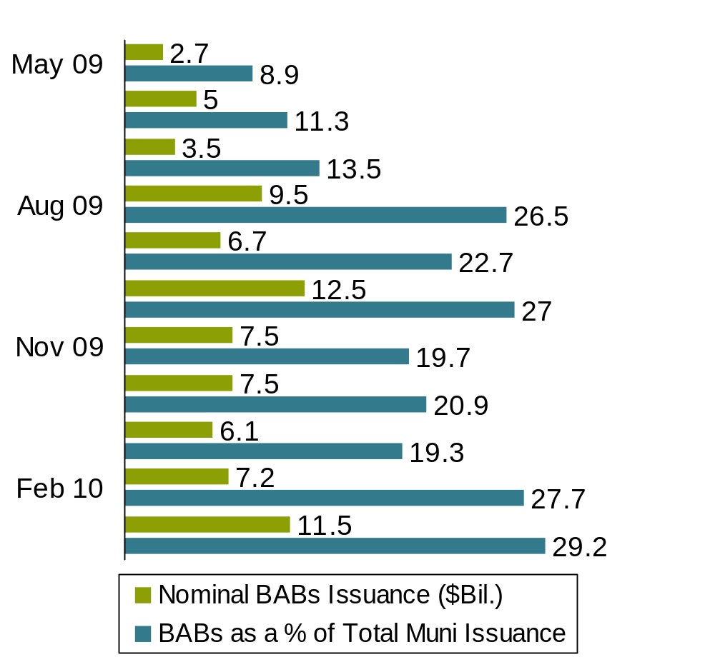
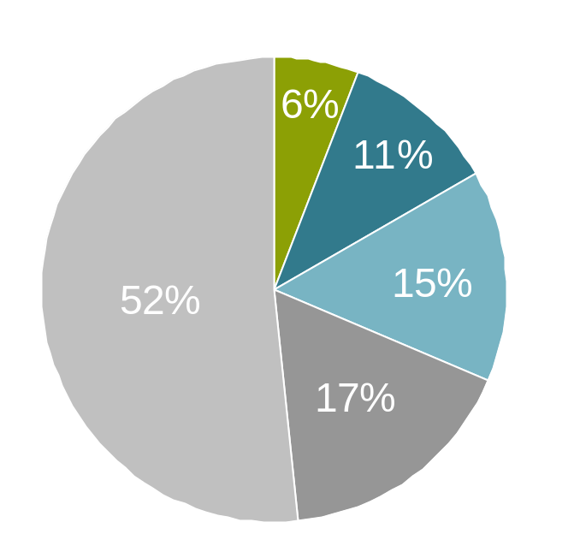
Surge in Build America Bond Issuance Favorable for Munis
BAB Maturity Distribution
BABs Issuance
1–10 years
%
%
10–15
%
%
15–20
%
25+
%
%
%
20–25
%
%
%
Left chart as of March 31, 2010; right chart as of March 26, 2010
Data is subject to change.
Source: JPMorgan Chase and AllianceBernstein
Notes:
Part of the US government’s rescue program involved the creation of the Build America Bonds Program (also known as BABs).
BABS allows a municipality to issue taxable bonds and receive a tax credit, making it an attractive source of funding for municipalities. Not surprisingly, there’s been a lot of issuance of these types of bonds. And the program is likely to be extended for another three years, leaving the window open for municipalities to issue bonds in the taxable bond market rather than the muni market.
Let me state clearly that BABs are NOT tax-exempt investments like traditional munis.
So far, municipalities have taken advantage of the BABs opportunity, predominantly by issuing longer-maturity bonds. The illustration on the left shows the maturity distribution of BABs—over half have been issued with maturities of 25 years or greater.
By giving municipalities another way to raise capital, BABs are becoming a growing part of the total bond issuance of municipalities. And if municipalities are issuing more BABs, it means they’re not issuing as many tax-exempt municipal bonds. The law of supply and demand says that when the supply of munis slows down, it can be favorable for the prices of existing muni bonds.

Slide 25
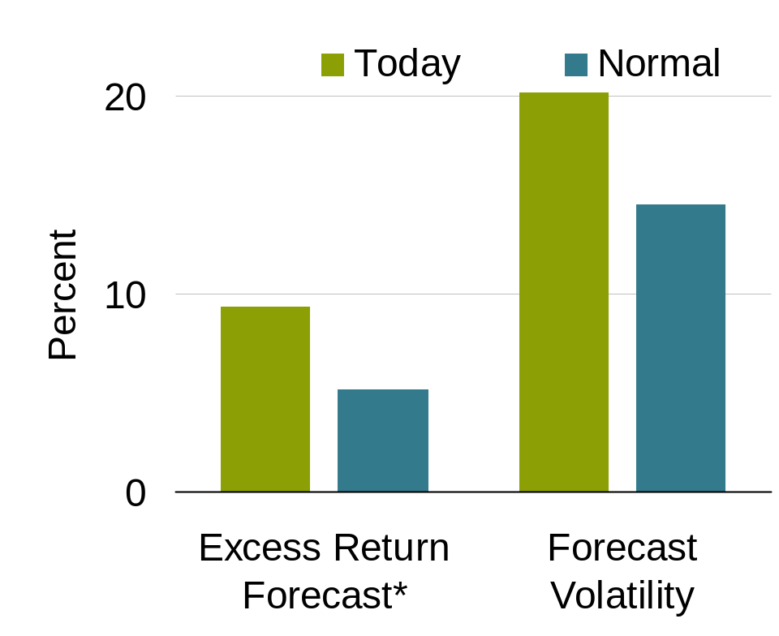
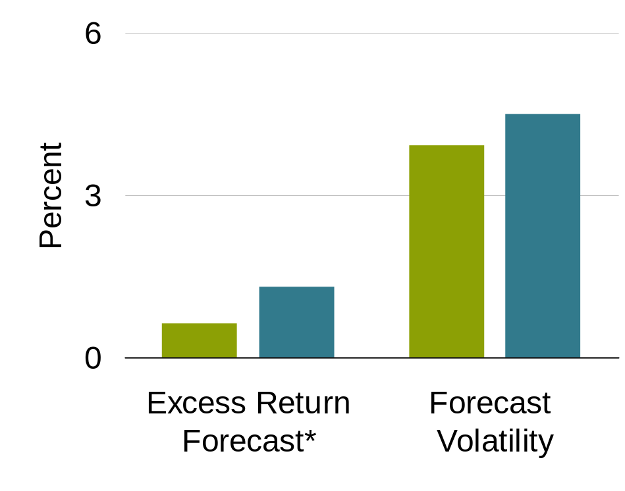
Viewing Markets from a Portfolio Perspective
Stocks
Our forecast returns are elevated, but so is risk
Bonds
Our forecast returns are lower than normal, as is risk
Future projections may not come to pass.
As of May 10, 2010
12 month forecast
*Over US cash
The above analysis is based on AllianceBernstein’s proprietary model. Normal is AllianceBernstein's proprietary forecast of asset class returns and risks when markets are in long-run equilibrium.
Source: AllianceBernstein
Notes:
We’ve discussed the state of the economy and explored select opportunities among various asset classes. But there’s a broader question to consider: how might our assessments of the capital markets, particularly stocks and bonds, translate into an overall portfolio perspective?
Let me point out that the goal of this assessment is not to attempt to add alpha through tactical changes to a portfolio’s asset allocation. AllianceBernstein firmly believes that a long-term, strategic asset allocation approach is critical. But we do think there are opportunities to make modest adjustments to portfolio allocations in an effort to reduce volatility without sacrificing long-term returns.
By looking at the volatility and return potential of different asset classes and the correlations between them, our research can provide an assessment of when it may be prudent to overweight or underweight stocks or bonds.
As I’ve mentioned earlier, we expect a continued, though uneven, recovery, and cyclical, structural and policy-related risks are still higher-than-normal. Based on our research inputs and this assessment, we’d expect both returns and risk to be above normal for stocks and below normal for bonds.
So, for a typical balanced portfolio of 60% global stocks and 40% global bonds, that assessment would suggest adhering to an allocation range in line with that objective.

Slide 26
Anxiety Creates Opportunity
Economic recovery is showing signs of sustainability
Policy risks remain, especially surrounding government indebtedness
Uncertainty about the future and global rebalancing generate investment opportunities for active managers
Notes:
So, to conclude:
The economic recovery is showing signs of sustainability
Policy risks remain, especially surrounding government indebtedness
Uncertainty about the future and a “new mix” of global economic patterns generate investment opportunities for active managers
Thank you. I’ll be happy to take your questions now.

Slide 27
A Word About Risk
Past performance is no guarantee of future results. The investment return and principal value of an investment in any Fund will fluctuate as the prices of the individual securities in which they invest fluctuate, so that shares, when redeemed, may be worth more or less than their original cost.
Value investing does not guarantee a profit or eliminate risk. Not all companies whose stocks are considered to be “value” stocks are able to turn their business around or successfully employ corrective strategies that would result in stock prices that rise as initially expected.
Investments in foreign securities may magnify fluctuations due to changes in foreign exchange rates and the possibility of substantial volatility due to political and economic uncertainties in foreign countries. Because a Fund may invest in emerging markets and in developing countries, an investment also has the risk that market changes or other factors affecting emerging markets and developing countries, including political instability and unpredictable economic conditions, may have a significant effect on a Fund's net asset value.
Investing in non-US securities may be more volatile because of political, regulatory, market and economic uncertainties associated with such securities. These risks are magnified in securities of emerging or developing markets.
As interest rates rise, bond prices fall and vice versa – long-term securities tend to rise and fall more than short-term securities.
While a Fund may invests principally in common stocks and other equity securities, in order to achieve its investment objectives, a Fund may at times use certain types of investment derivatives, such as options, futures, forwards and swaps. These instruments involve risks different from, and in certain cases, greater than, the risks presented by more traditional investments. These risks are fully discussed in each Fund’s prospectus.
Notes:
Read to audience

Slide 28
Index Descriptions
Following is a description of the indices referred to in this presentation. It is important to recognize that all indices are unmanaged and do not reflect fees and expenses associated with the active management of a mutual fund portfolio. Investors cannot invest directly in an index, and its performance does not reflect the performance of any AllianceBernstein mutual fund.
Standard & Poor's Index (S&P 500) Widely regarded as the best single gauge of the US equities market, this world-renowned index includes a representative sample of 500 leading companies in leading industries of the US economy. Although the S&P 500 focuses on the large-cap segment of the market, with over 80% coverage of US equities, it is also an ideal proxy for the total market. The S&P 500 is part of a series of US indices that can be used as building blocks for portfolio construction. With close to $1 trillion in indexed assets, the S&P US indices have earned a reputation for being not only leading market indicators, but also investable portfolios designed for cost efficient replication or the creation of index-linked products.
MSCI Europe Index is a free float-adjusted market capitalization weighted index that is designed to measure the equity market performance of the developed markets in Europe. As of June 2007, the MSCI Europe Index consisted of the following 16 developed market country indices: Austria, Belgium, Denmark, Finland, France, Germany, Greece, Ireland, Italy, the Netherlands, Norway, Portugal, Spain, Sweden, Switzerland, and the United Kingdom.
Morgan Stanley Capital International (MSCI) World Index is a market capitalization–weighted index that measures the performance of stock markets in 23 countries.
Morgan Stanley Capital International (MSCI) Emerging Market Index is a free float–adjusted market capitalization index that is designed to measure equity market performance in the global emerging markets. It consists of 26 emerging market country indices.
TOPIX Index measures stock prices on the Tokyo Stock Exchange (TSE).
VIX Index or Chicago Board Options Exchange (CBOE) Volatility Index shows the market's expectation of 30-day volatility constructed using the implied volatilities of a wide range of S&P 500 index options.

Slide 29
Index Descriptions (continued)
Barclays Capital US Dollar Emerging Market Index includes USD-denominated debt from emerging markets in the following regions: Americas, Europe, Middle East, Africa, and Asia. As with other fixed income benchmarks provided by Barclays Capital, the index is rules-based, which allows for an unbiased view of the marketplace and easy replicability.
Barclays Capital Global Aggregate - Corporate Bond Index tracks the performance of investment grade corporate bonds publicly issued in the global market found in the Global Aggregate.
Barclays Capital Global High Yield Index provides a broad-based measure of the global high-yield fixed income markets. The Global High-Yield Index represents that union of the U.S. High-Yield, Pan-European High-Yield, U.S. Emerging Markets High-Yield, CMBS High-Yield, and Pan-European Emerging Markets High-Yield Indices.
Barclays Capital US Corporate High Yield Index covers the USD-denominated, non-investment grade, fixed-rate taxable corporate bonds that are classified as high-yield in the middle rating of Moody’s, Fitch and S&P is Ba1/BB+/BB+ or below. Excludes Emerging Markets.
Barclays Capital Commercial Mortgage-Backed Securities (CMBS) Index tracks the performance of US dollar denominated commercial mortgage-backed securities publicly issued in the US domestic market.
Barclays Capital US Treasury Index includes fixed-rate, local currency sovereign debt that make up the US Treasury sector of the Global Aggregate Index.
Barclays Capital Japan Treasury Index includes fixed-rate, local currency sovereign debt that make up the Japanese Treasury sector of the Global Aggregate Index.
Barclays Capital Euro Treasury Index includes fixed-rate, local currency sovereign debt that make up the Euro Treasury sector of the Global Aggregate Index.
Barclays Capital Global Treasury Canada Index represents the Canada component of the Global Treasury index.
Barclays Capital Global Treasury - United Kingdom Index is the United Kingdom component of the Global Treasury index.
Barclays Capital Global Treasury - Australia Index is the Australia component of the Global Treasury index.
JP Morgan Emerging Markets Bond Index Plus (EMBI+) tracks total returns for external-currency-denominated debt instruments of the emerging markets: Brady bonds, loans and Eurobonds. It offers coverage of 21emerging market countries

Slide 30

Region: | Global
Division: | Global
Name: | Screenshow End Page
Use: | Between speakers and as an end page for a Screenshow presentation Not used for a standard print book Do not re-size logo
Other:
17178
AllianceBernstein Investments, Inc. (ABI) is the distributor of the AllianceBernstein family of mutual funds. ABI is a member of FINRA and is an affiliate of AllianceBernstein L.P., the manager of the funds.
©2010

